Slide 1


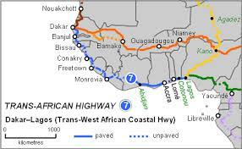
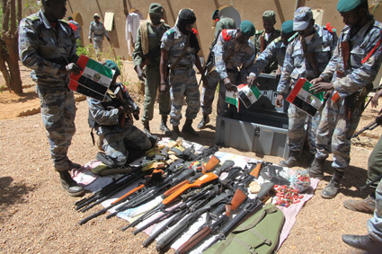
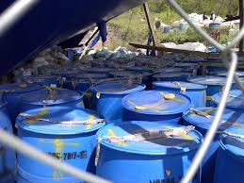
West Africa Security Project
26th Conference of Directors General of Customs of
the World Customs Organization for the West and
Central Africa Region - 28 April 2021

Slide 2
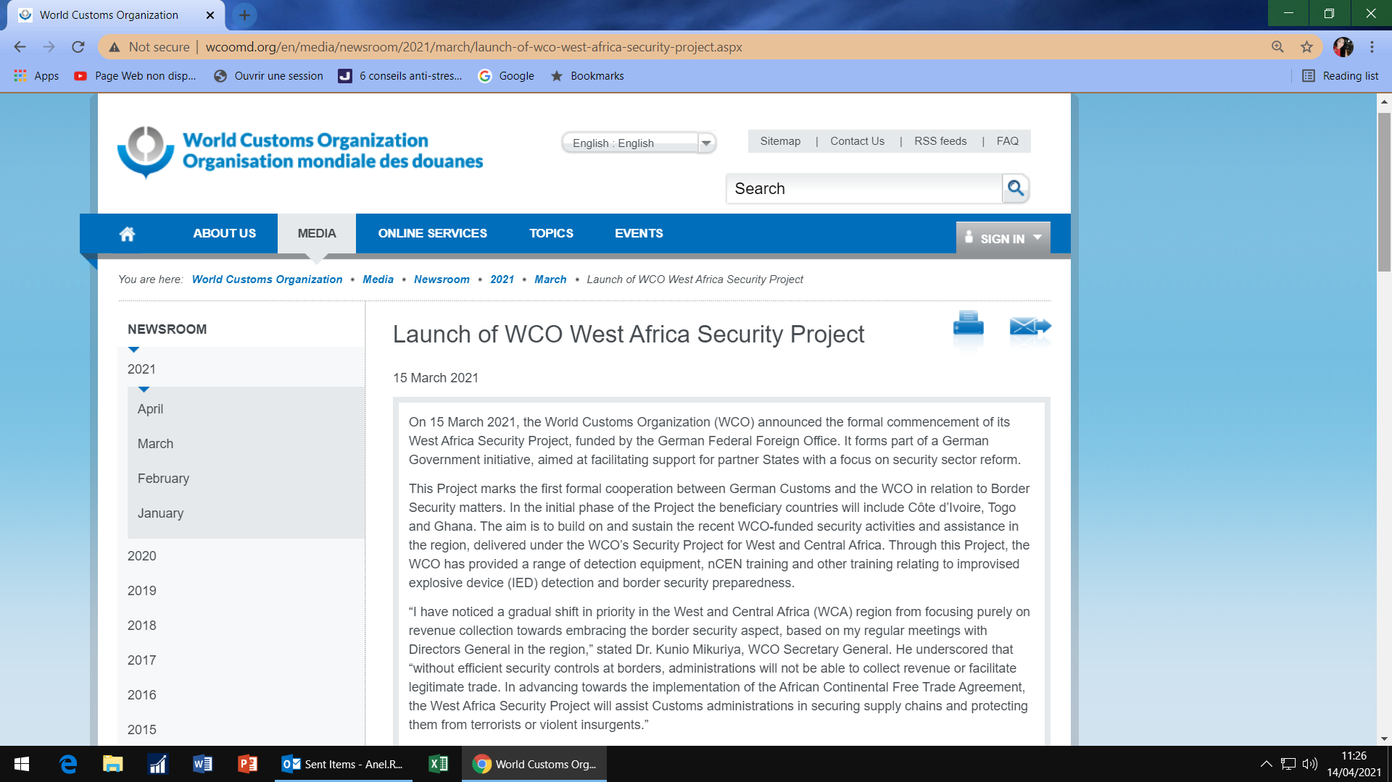
West Africa Security Project
Article «Launch of the WCO Security Project in West Africa
on the “WCO Web Site” on 15 March 2021
This is a project funded by the German Federal Ministry of Foreign Affairs

Slide 3
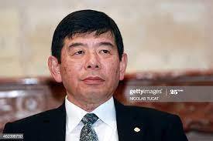
West Africa Security Project
Extracts from the opening speech
Mr. Kunio Mikuriya, Secretary-General of the WCO:
«I have noticed a gradual shift in priority in West and Central Africa (WCA)
region from focusing purely on revenue collection towards
embracing the border security aspects, based on my regular
meetings with Directors General in the region.»

Slide 4
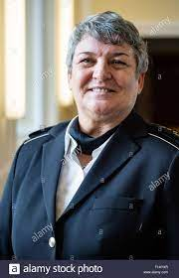
West Africa Security Project
Extracts from the opening speech
Mrs. Colette Hercher, President of the General Directorate of
German Customs
« It gives me a great pleasure to lounge this initiative, which marks the
first project in the West Africa region entered into by the
German Custom Administration.
I’m therefore delighted to have the WCO as a committed project partner by
our side, as its project experience and contacts in these region will add a great deal
of value to this initiative ».

Slide 5
West Africa Security Project
What are the objectives of this project?
The West Africa Security Project (WASP) will initially focus on a “diagnostic phase” where the situation in the major seaports, airports and land border crossings in Ghana, Cote D’Ivoire and Togo that serve the West African region will be assessed in order to establish how better revenue and security related Customs procedures in these locations can be implemented.

Slide 6
West Africa Security Project
What are the objectives of this project?
The Project team will assess how shipments of Improvised Explosive Devices (IED) precursor chemicals and components, Small Arms and Light Weapons (SALW), Weapons of Mass Destruction (WMD) components and cash used for terrorism financing could be more effectively identified through the enhanced us of WCO Instruments and Tools, which include:
Cargo Targeting System (CTS);
Compendium of Customs Operational Practices for Enforcement and Seizures (COPES);
Customs Enforcement Network (CEN) Suite; and
Global Travel Assessment System (GTAS).
ETC…

Slide 7
West Africa Security Project
First Step: Diagnostic Phase
Preparation of two questionnaires «Self-assessment maturity tool». This tool is part of the diagnostic framework of the WCO and is based on the self-assessment maturity tool developed under the WCO “COPES Programme”.
The questionnaires are sent to the correspondent designated by the Director-General/Commissioner-General.
Creation of an Adhoc group in the three countries to answer these questionnaires.
Virtual meetings (Zoom) with the two WCO project experts to finalize the assessment tools.

Slide 8
West Africa Security Project
First Assessment Questionnaire
(content)
Organizational Role and Responsibilities questions:
(Type of missions –fiscal – economic - security; Conventions ratified and
implemented; Provision for the control, LEA, Investigation; etc.…)
B. Organizational Structure questions:
(Implementation of enforcement directorate, Intelligence, Investigations;
Mobile enforcement units, K9 Units, enforcement unit responsible
for illicit financial flows; etc…)
C. Systems and Technology questions:
(computerized Customs Management/Clearance system ; passenger
targeting system; Customs offenses/seizures database; scanners;
test equipment/kits; laboratories to analyze products; etc…)
D. Trade and Seizure Data Questions:
(Seizures, Goods in Transit, Targeted Products in the “Global Shield Program)

Slide 9
West Africa Security Project
Second Assessment Questionnaire
(content)
Compliance: (Examples)
(Seized goods management system; Power to confiscate seized goods;
Infrastructures, Equipment for controls, etc.)
B. Intelligence:(Examples)
(Codification for the processing of information/Evaluation system;
Participation in the work of the RILO; Access to databases; Training; etc.)
C. Risk management:(Examples)
(Application of risk management; Use of selectivity criteria; MOU’S on a national or
international level; Training; etc.)
D. Enforcement:(Examples)
(Right to body search; Right to detain/arrest persons; right of home search;
Use of CENcomm; Training; etc.)
E. Investigation:(Examples)
(Administrative/Judicial Investigations; Controlled deliveries; Search and preservation
of evidence; Initial and advanced training on investigation; etc.)
F. Gender Equality: (Examples)
(Questions dealt with by a German customs expert)

Slide 10
West Africa Security Project
Next steps
June 2021: Diagnostic mission to the three target countries for the
two WCO experts).
(contingent on state of pandemic evolution – Covid 19)
End of June 2021: Assessment report finalised:
- Assessment report based on questionnaire responses. With proposals
for strengthening capacity for Phase Two of the Project (see next slide)
- Report on the risk assessment for the implementation of phase two
of the project.
15 - 30 July: Preparation of agenda and organization of a high-level
meeting (Target Countries DG – WCO - Sponsor)
(conditioned by state of pandemic evolution – Covid 19).

Slide 11
West Africa Security Project
Next steps: Draft Deliverables for Phase Two of the Project
Organize a project launch event for Customs DGs, International and National
Organizations and Agencies involved in regional counter-terrorism and
border security initiatives.
This event could take place early in Phase 2.
Organization of awareness-raising activities, training, training of Trainers
(on COPES Project, Global Shield Project (PGS), nCEN tool, Freight Targeting
System (CTS), Passenger Assessment and Targeting System (GTAS) ),
etc.…

Slide 12
West Africa Security Project
Next steps: Draft Deliverables for Phase Two of the Project (Continued)
Identify the main transit corridors between the main ports and airports
of West Africa (Togo, Ghana, Côte d'Ivoire) and the hinterland of the
Sahel countries, perhaps through geo-location tools.
Implementation of a regional border security and surveillance
operation(s).
A Security conference to address challenges of illicit trade
and security.
ETC…

Slide 13
West Africa Security Project
West Africa Security Project Team
James McCOLM Head of the WCO Security Project
T: +32 (0)2 209 9640 / +32 (0)479 801513
James.McColm@wcoomd.org
Terry WALL Security Project Expert West Africa
for Ghana
T: +32 (0)2 209 9519 / +61 448 050520 (M)
terence.wall@wcoomd.org
Pierre BERTRAND Security Project Expert West Africa
for Côte d’Ivoire and Togo
T: +33 647804637
Pierre.bertrand@wcoomd.org
Anel Redjeb Project Assistant, West Africa
T: +32 (0)2 209 9273 / +32475949716
Anel.redjeb@wcoomd.org

Slide 14
West Africa Security Project
Thank you for your attention
Questions ?

